Slide 1
Literature Survey on Temporal Graph Stores and Processing Presentation - 3
Shriram R
07-Jun-19

Slide 2
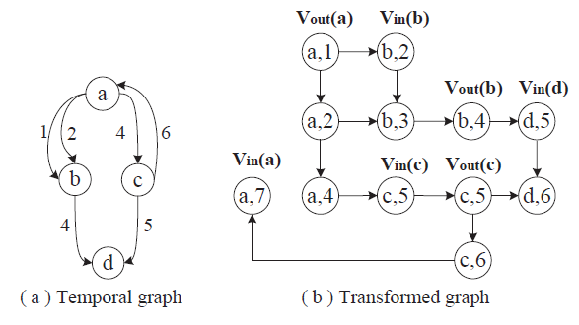
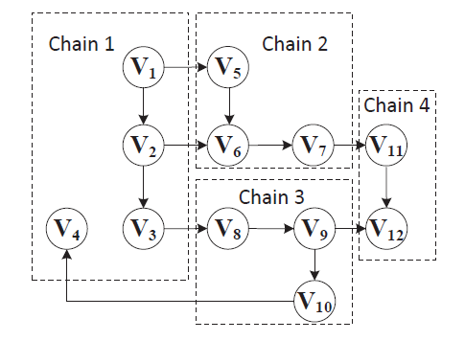
Reachability and Time-Based Path Queries in Temporal Graphs [1]
TopChain – Labelling Scheme for reachability queries
Chains are ranked in random or by max. degree
Each node is assigned top-k inV and outV labels

Slide 3
Reachability and Time-Based Path Queries in Temporal Graphs [1]
Performance Evaluation – 1 node, 2.0GHz, 128 GB RAM
Compared with PWAH8, TOL, GRAIL++, Ferrari, IP+, TTL, 1-pass
15 real temporal graphs with max. 273,909 snapshots
Index size is considerably close to other baselines
In average an order of magnitude improvement in query time
Gaps:
No distributed version of index structure
No support for path/reachability queries with property predicates

Slide 4
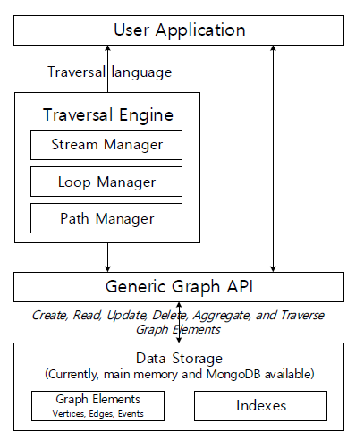
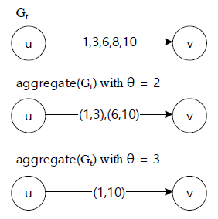
ChronoGraph: Enabling temporal graph traversals for efficient information diffusion analysis over time [2]
Traversal based query engine for Temporal graphs
Support for aggregating time points to intervals

Slide 5
ChronoGraph: Enabling temporal graph traversals for efficient information diffusion analysis over time [2]
Four types of steps in traversal :
Transform, filter, sideEffect & branch
Parallelized existing graph traversal methods & use lazy evaluation
Evaluation: Corei7, 32 GB memory, 16 GB heap environment
4 datasets with largest being 40M edges
Implemented temporal BFS, DFS and SSSP
Obtained up to an order of magnitude improvement
Compared with Neo4j, Titan, OrientDB etc.

Slide 6
References
Wu, Huanhuan, et al. "Reachability and time-based path queries in temporal graphs." 2016 IEEE 32nd International Conference on Data Engineering (ICDE). IEEE, 2016.
Byun, Jaewook, Sungpil Woo, and Daeyoung Kim. "ChronoGraph: Enabling temporal graph traversals for efficient information diffusion analysis over time." IEEE Transactions on Knowledge and Data Engineering (2019).

